Slide 1
Testing conventional Application
Chapter 18

Slide 2
Software Testing
A more appropriate definition is:
“Testing is the process of executing a program with the intent of finding errors”.

Slide 3
Test case design techniques
Functional Testing (Black Box Testing)
Equivalence Partitioning
Boundary Value Analysis
Comparison Testing
Structural Testing (White Box Testing)
Basis Path Testing
Control Structure Testing

Slide 4
Basis Path testing
For Deriving Test Cases
Step 1: Using the design or code, draw the corresponding flow graph.
Step 2: Draw the DD Path Graph
Step 3: Determine the cyclomatic complexity of the flow graph
Step 4: Determine a basis set of independent pahts
Step 5: Prepare test cases that will force execution of each path in the basis set

Slide 5
Control flow graph
The control flow of a program can be analyzed using a graphical representation known as flow graph. The flow graph is a directed graph in which node represents statement, and edges represents flow of control.
In other word, a control flow graph describes how the control flows through the programs.

Slide 6
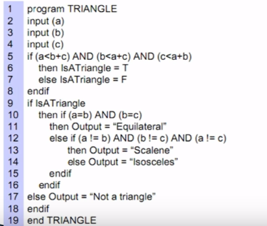
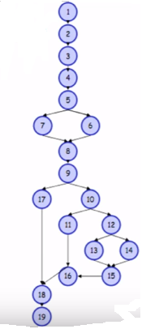
Control flow graph(CFG)

Slide 7
DD path graph
Flow graph generation is the first step of path testing. The second step is to draw a DD path graph from the flow graph.
The DD path graph is known as decision to decision path graph. Here, we concentrate only on decision nodes.
The nodes of flow graph, which are in a sequence and combined in a single node.
DD path graph is a directed graph in which nodes are sequence of statements and edge represent control flow between nodes.

Slide 8
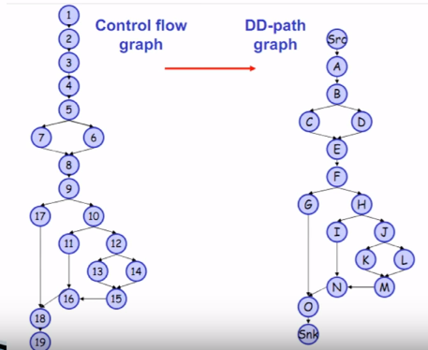

Slide 9
Independent path
The DD path graph is used to find independent paths. We are interested to execute all independent paths at least once during path testing.
It is quite interesting to use independent paths in order to insure that
Every Statement in the program has been executed at least once.
Every branch has been exercised for true and false condition.

Slide 10
Cyclomatic complexity V(G)
First Method: McCabes cyclomatic metric of a graph G.
V(G) = e – n + 2
where e = edges
n = nodes
P = Connected Components
Second Method: predicate node + 1
Third Method: number of Regions

Slide 11
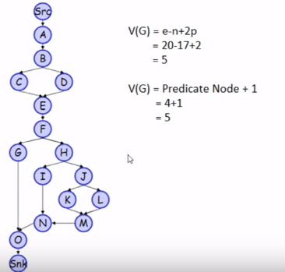
Cyclomatic Complexity

Slide 12
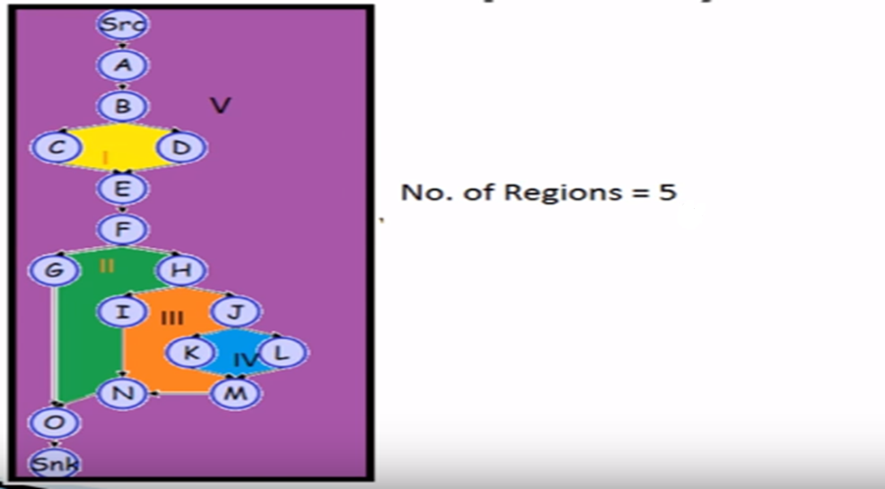
Cyclomatic Complexity

Slide 13
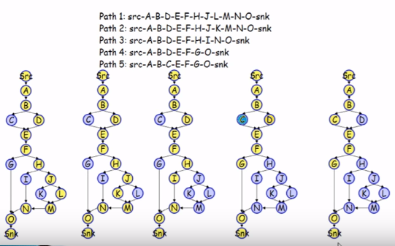
Independent Path

Slide 14
Black box testing
“Functionality of software under test is checked without looking at the internal code structure, implementation details or knowledge of internal paths of the software”.

Slide 15
Gray Box Testing
Gray box testing is the testing of software application using effective combination of both White box testing & Black box testing method.
In the Gray box testing tester is usually has knowledge of limited access of code and based on this knowledge the test cases are designed.
In Gray box testing, tester doesn’t have the knowledge in detailed.
To test the Web Services application usually the Gray box testing is used.

